Slide 1
CHURN PREDICTION
Presented by
Ritesh Mishra
Chandan Nishad

Slide 2
Problem statement
Customer churn is the focal concern of most companies and telecommunications industry can be considered in the top of the list with an approximate annual churn rate of 30%.
It is clear that spending money holding on to existing customers is more efficient than acquiring new customers This means wasting the money and efforts as it has been rightly mentioned " it is like adding water to the leaking bucket"..
In order to tackle this problem we must recognize the churners before they churn, so developing a model which predicts the future churners seems to be vital.

Slide 3
Objective of the project
The purpose of this project is to find an efficient and accurate predictive model for customer churn in telecommunication industry by utilizing machine learning techniques.
By predicting which customers are likely to churn, the telecommunication company can reduce the rate of churn by offering the customer new incentives to stay.
By understanding why customers churn the telco can also work on changing their service so as to satisfy these customers ahead of time .

Slide 4
Data exploration
Data exploration is a very important part of any analytics project and quite a bit of effort goes into it.
Primarily, the objective of exploration is to get a good idea about how the data looks, preprocess data to remove outliers, impute missing values and get cues towards feature engineering.
We have used R for data exploration and model building and Hadoop / Spark for fast computation .

Slide 5
Steps taken
1) For the model to draw a pattern, continuous data was required. Hence we took five months of continuous data.
2) We stored the data i.e. different CSVs in Hadoop distributed file system(HDFS) and each month's data was fetched and imported to R.
3) For July data we read the pay, usage and data CSVs into R. We merged these three files by the common column "id".
4) If all are NAs in a particular row, we deleted that row because of lack of data for our convenience.
5) After that we removed the duplicate records in the July file(as there were ids getting repeated)
6) We found out the outliers using the Q3+1.5*IQR, Q1-1.5*IQR and imputed them with NA.

Slide 6
Steps taken contd.
7) NAs in every column were replaced with median, mean and mode for numerical data, integer data and categorical data respectively.
8) New variables were formed from the existing variables. The NaNs were replaced with 0.
9) Next we changed the date format in the activation date and imputing all the NA in this column with the first date of July.
10) The august data was fetched and the same process was repeated. Finally July and August data were merged.
11) There were two activation date columns. So we transferred the activation dates of August to July and dropped the activation date column of August.
12) We fetched September data, did all the steps of preprocessing and merged with merged July and august data.

Slide 7
Steps taken contd.
13) After transferring the activation column of September to merged July and August data, we dropped the activation column of September.
14) We repeated the same process for October and November. We dropped the rows with all NAs and imputed the remaining NAs with 0.
15) Then we read the disconnection file. We assigned 1 to churn and merged with our five months data. The NAs after merge were imputed with 0.
16) There was a date column in the disconnection file. After merge, the NAs of this column was replaced with the last date of November as this date is the last date for our consideration.

Slide 8
Steps taken contd.
17) We removed all the rows with NAs and calculated the no of days the customer is associated with the system.
18) After dropping few irrelevant columns, we had the single view of our data for developing the model.
19) We divided the data 70% and 30% into training(1190452 rows and 197 columns) and test data with 510194 rows respectively.
20) We used logistic regression and developed the model. We ran the code in Spark cluster for fast computation.

Slide 9
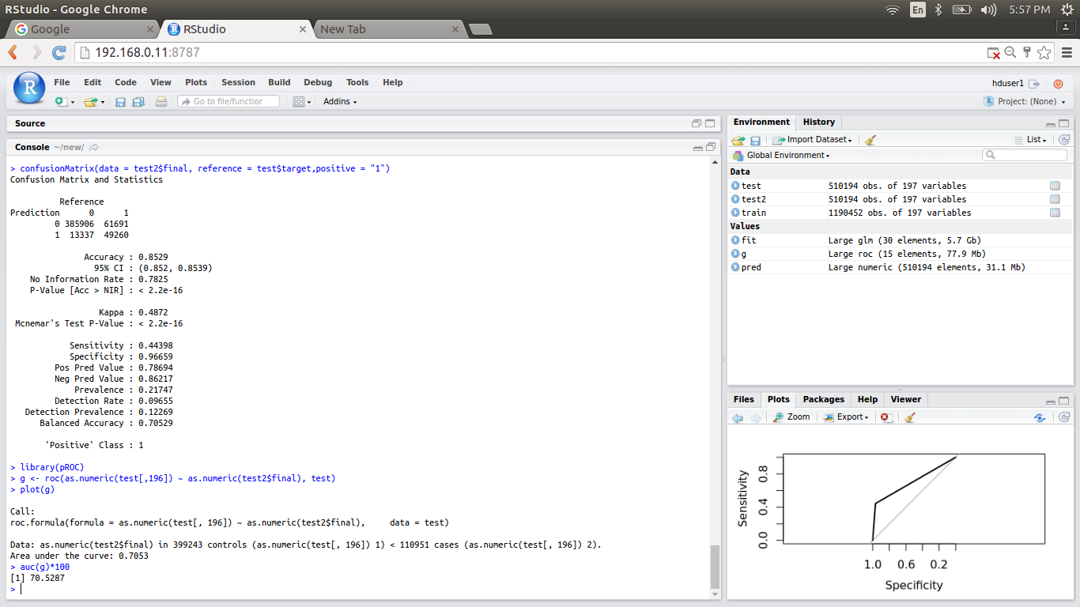
RESULT

Slide 10
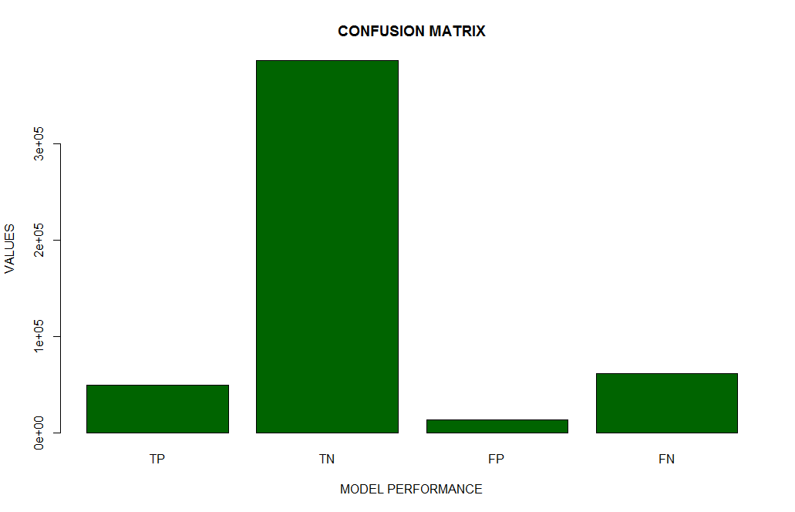
Confusion matrix Graph

Slide 11
Thank You

